Slide 1
Developing on AWS
Coding Games
Notes:
In this module, we’ll talk about how to consider costs while designing your systems on AWS.

Slide 2
Disclaimers, warnings and tips
This content is not released, licensed or authorized by Amazon Web Services. It is the work and responsibility of its rogue instructors.
Each exercises is divided by level of difficulty. Feel free go through all the basics or deep dive in your favorite.
Group with other students, divide and conquer.
Keep it simple. Focus on AWS APIs and exercise requirements.
When testing your applications, use EC2 Instances as the training facility network may bottleneck your application.

Slide 3

Terminator Game

Slide 4
Terminator: Journeyman Level
Write a program to exterminate all EC2 instances, RDS Databases, SQS Queues and SNS Topics in a given region

Slide 5
Terminator: Master Level
Write a program to exterminate all AWS resources in a given region

Slide 6
Terminator: Guru Level
Write a program to exterminate all AWS resources in all regions

Slide 7
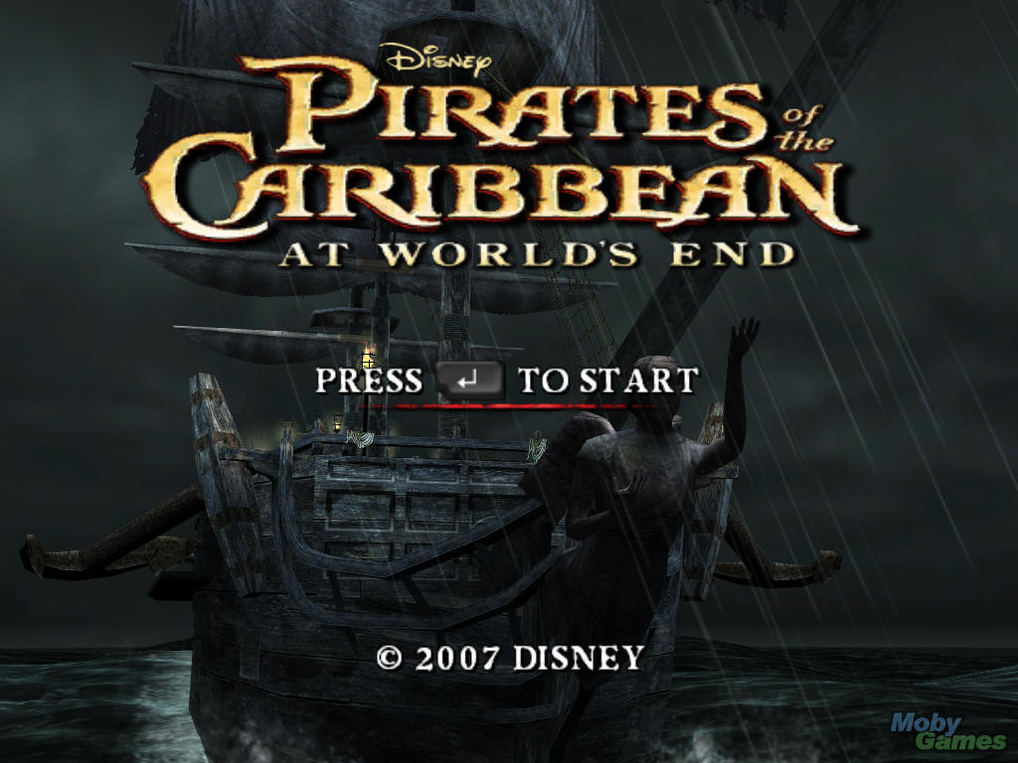
Pirates Game

Slide 8
Pirates: Journeyman Level
Develop a simple file sharing website:
Users must be authenticated to list or download files
Every authenticated user can download every file
All files must be uploaded to S3

Slide 9
Pirates: Master Level
Use signed URLs to prevent cross-site linking
Allow torrent downloads
Distribute static content using CloudFront

Slide 10
Pirates: Guru Level
Upload files in parallel to S3
Create a CloudFormation Stack and deploy your solution to 3 regions
Use Route53 to redirect users to their closest region

Slide 11

Full Throttle Game

Slide 12
Full Throttle – Journeyman Level
Create an producer application that sends random financial transaction events to a DynamoDB table with 10 write units.
Suggested Table Structure
Hash Key: Transaction Source (User Account)
Range Key: Transaction Timestamp
Other Attributes: Transaction Type (Buy/Sell), Transaction Object (Stock Quote), Transaction Ammount, Unitary Value …
Start the application many times so that it exceeds your provisioned write units.
How much throughput (events/minute) can your architecture handle without errors in this stage?
Hint: Use a CloudWatch metric

Slide 13
Full Throttle – Master Level
Change the producer application to send events to an SQS queue instead of sending directly to DynamoDB
Create an consumer application that reads from this queue and writes them to DynamoDB
Set up auto-scaling for the consumer application based on the queue size
How much throughput (events/minute) can your architecture handle without errors in this stage?

Slide 14
Full Throttle – Guru Level
Create a MySQL RDS database with db.m1.small type, without provisioned IOPS and default settings
Create a new SQS Queue to receive events for MySQL
Create a SNS Topic to fan-out events to both DynamoDB and MySQL
Create a consumer application for the MySQL database
What is the throughput difference between the RDS and DynamoDB table?

Slide 15


